Slide 1


CI / CD using Jenkins
Maksym Zinkevych
MARCH 1, 2016

Slide 2
CONTENTS
1
CI/CD basics
2
Meet Jenkins
3
Installation and initial setup
4
Jenkins slaves
5
CI/CD using Jenkins

Slide 3
CI/CD basics
CI/CD benefits
Deliver software as soon as possible
Always ready to release
Bugs are detected early
Constant high quality of code
Fast feedback between customers users and developers
Optimal using of human resources
Overhead to support CI/CD
Potential necessity in a dedicated server
CD\CD drawbacks

Slide 4
CI/CD basics
CI/CD principles
Use a revision control system (Git, Subvesion etc.)
Commit frequently
Create scripts to build and deploy
Create auto tests
Create a delivery pipeline with fast feedback
Manage configuration and dependencies
Make sure that your development team agree to use these principles

Slide 5
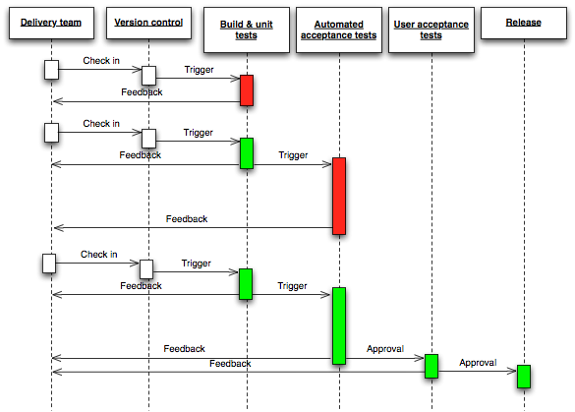
CI/CD basics
Delivery pipeline

Slide 6
Meet Jenkins
Jenkins features
Multi-platform (written in Java)
Easy to install and configure
Get code from a revision control system (Subvesion, Git etc.)
Build a project by an event, a schedule or on demand
Ability to build projects in parallel or on a grid of nodes
Run auto tests
Run scripts in Unix shell, Windows shell, Groovy or Python
Notify about results
Visualize status of a project
Has a REST API and CLI
Has more than 1000 plugins

Slide 7
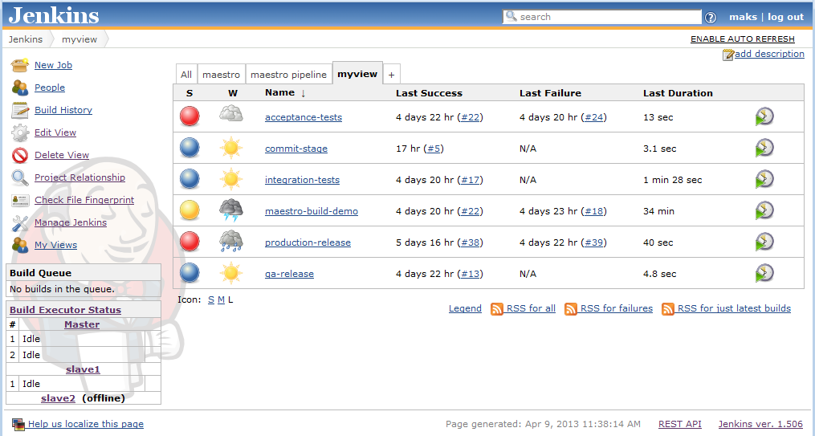
Meet Jenkins
Jenkins dashboard

Slide 8
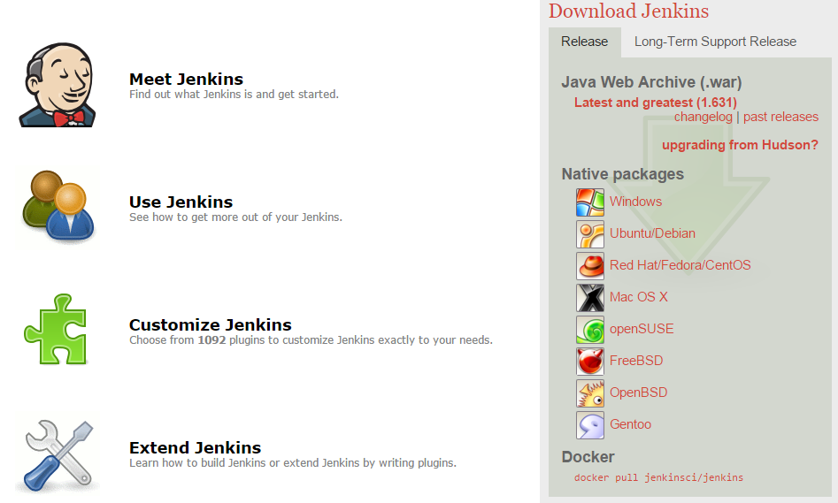
Installation and initial setup
http://jenkins-ci.org/

Slide 9
Installation and initial setup
wget -q -O key http://pkg.jenkins-ci.org/debian/jenkins-ci.org.key
sudo apt-key add key
GET REPOSITORY KEY
1
/etc/apt/source.list:
deb http://pkg.jenkins-ci.org/debian binary/
UPDATE REPOSITORYLIST
2
sudo apt-get update
sudo apt-get install jenkins
INSTALL PACKAGE
3

Slide 10
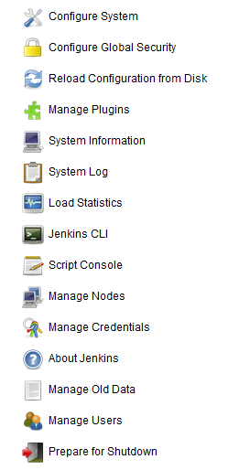
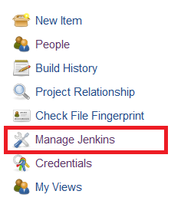
Installation and initial setup
Jenkins main menu

Slide 11
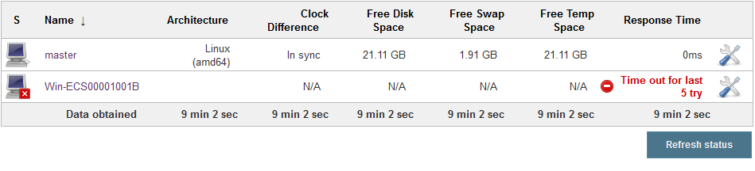
Jenkins slaves
Jenkins nodes

Slide 12
CI/CD with Jenkins
Jenkins project sections
Main and Advanced project options
Source Code Management
Build Triggers
Build Environment options
Pre Steps (optional)
Build Steps
Post Steps (optional)
Post-build Actions

Slide 13


CI/CD with Jenkins
Copy artifact plugin
Build & unit tests
Automated acceptance tests
User acceptance tests
Release

Slide 14
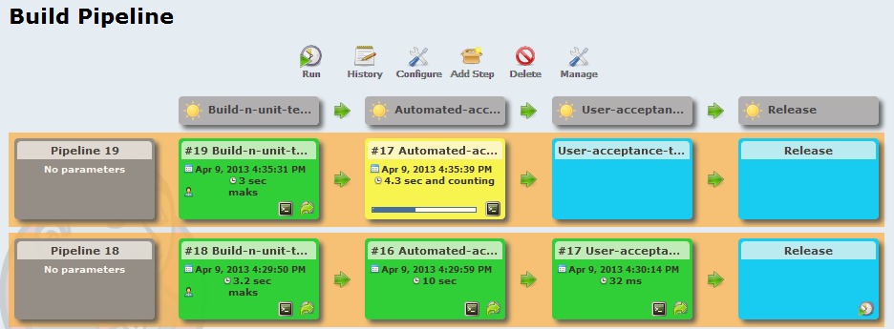
CI/CD with Jenkins
TRIGGER
Build & unit tests
Automated acceptance tests
User acceptance tests
Release
RUN

Slide 15
CI/CD with Jenkins
Promoted builds plugin
TRIGGER
PROMOTION STATUS
Build & unit tests
Auto tests
User acceptance tests
Release
RUN
Functional tests
Integration tests
Selenium tests

Slide 16
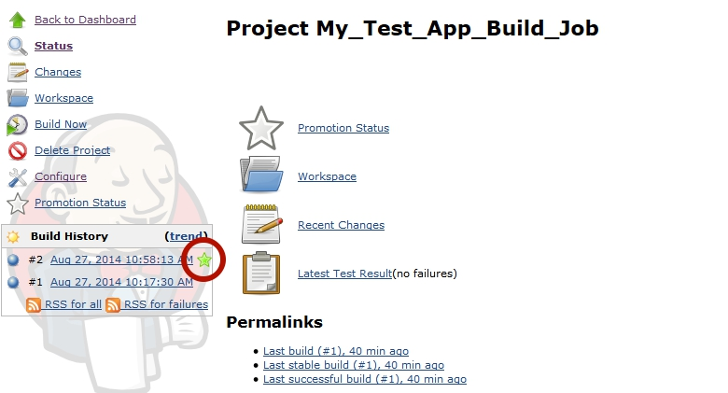
CI/CD with Jenkins
Promoted builds plugin

Slide 17
QUESTIONS

